Slide 1
Domain Driven Design
Diane Wilson
Fujifilm Medical Systems

Slide 2
Domain Driven Design
Part 1: Domain Models

Slide 3
Assumptions
We’re all experienced professionals
Enterprise applications
.NET centric?
Relational database centric?
Domain Driven Design can enhance our current processes
We can learn from each other

Slide 4
What is this “Domain” you speak of?
Real-world businesses that rely on complex software…
Health care delivery
Oil markets
Air traffic control
Power grid management
Multiple disciplines
Real world impacts

Slide 5
Domain Driven Design
Tackling complexity in the heart of software
Designing and using models
Communication and language
Caveats:
We are talking about (very) large projects
Greenfield and legacy
Not everything in a large application is well designed, and doesn’t have to be

Slide 6
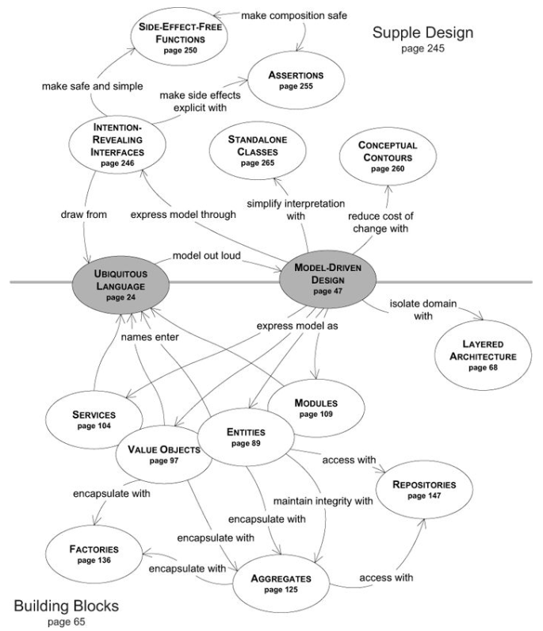
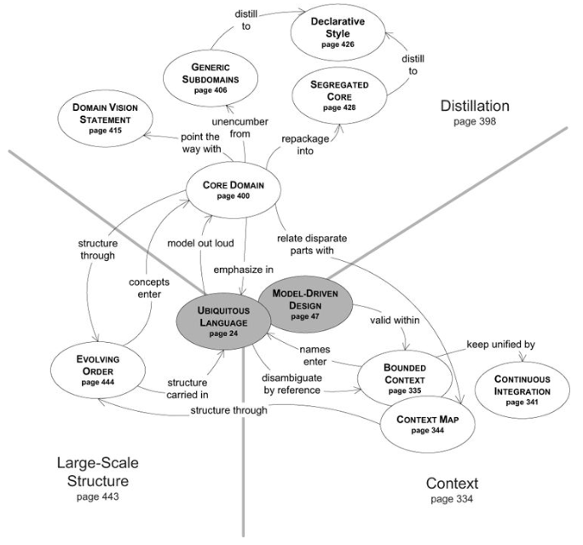

Slide 7
Domain Language
Example: “OPEN reversal of cartel controls, Saudi Arabia swing producer – inc or dec supply to control price. Chicken with shale producers. Don’t want to cede market share in Asia”
This is the language of someone’s domain
Who needs to understand it?

Slide 8
Ubiquitous Language
“Each resource within the RIS would have a field to assign a weighting factor for the dose information provided by that modality/equipment. The field would allow for calculation of a common factor for exposure to the patient regardless of manufacturer. In most cases this would be a simple multiplier, but in some cases would require more complex calculations. The intent is to provide a field for a physicist to add a consistent calculation that would be applied to all results received from a particular machine to normalize the data. Additional display values would also be optional to show per resource including adding the display value for CTDI, DLP, Organ Dose, Whole Body exposure, or other.”

Slide 9
Ubiquitous Language
The language of the domain experts
The language shared between business and developers
The language of the domain model
The language of collaboration

Slide 10
Value and Use of Models
“A model is not a document or diagram; it is the idea that the document or diagram describes.”

Slide 11
Effective Modeling
Binding the model and the implementation
Cultivating a language based on the model
Developing a knowledge-rich model
Distilling the model
Brainstorming and experimenting

Slide 12
Practices in Domain Analysis
Knowledge crunching
Continuous learning
Knowledge-rich design – nouns, activities, rules, policies, timing, events
Deep models

Slide 13
Benefits of Ubiquitous Language
Names of classes and prominent operations
Rules and terms needed to discuss rules
Organizing principles imposed on the model
Patterns the team applies to the domain model
Model relationships
Describes artifacts, tasks, and functionality
Pervasively shared between developers and domain experts
Carries large-scale aspects of design that don’t appear in code

Slide 14
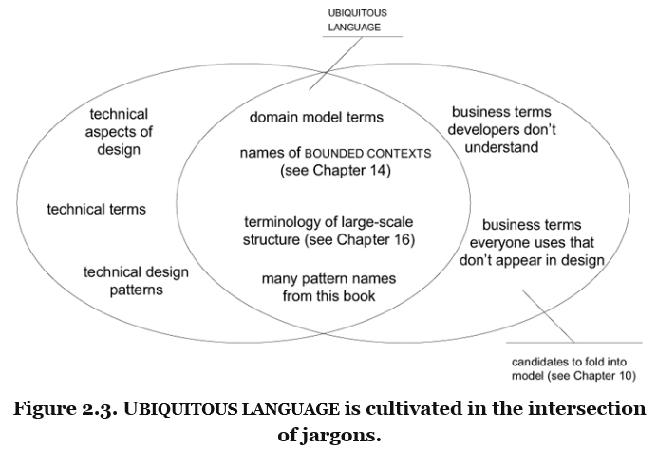

Slide 15
Ubiquitous Language is a Living Language
Changes in the language lead to changes in the model.
Refactor code to reflect changes in the model
Developers will point out imprecision or contradictions, engaging the domain experts in discovering workable alternatives
Exercising the model in spoken language exposes awkward details
Leads to clarity and simplification

Slide 16
One Team, One Language
Implementation details and technical components are not part of the language
If the domain experts don’t understand the model, something is wrong with the model
Domain experts use the language of the model to write uses cases and acceptance tests
Specialized jargon and technical details are extensions to the model

Slide 17
Documents and Diagrams
Simple, informal UML diagrams (three to five objects) can anchor discussion and brainstorming
UML cannot convey meaning of model concepts or behaviors
Natural language fills in the nuances of meaning

Slide 18
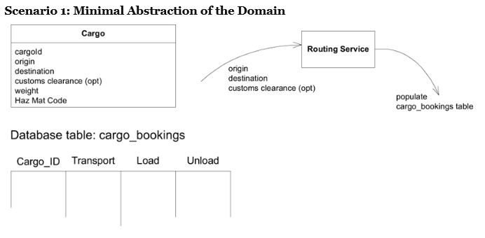
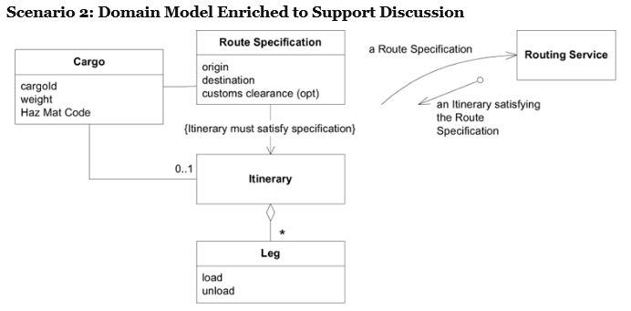
Abstractions Support Modeling

Slide 19
Model Documentation
Type | Advantages | Disadvantages
Code | Detailed, unambiguous, persistent | Difficult to convey meaning
Spoken | Ephemeral, localized | People outside the team need to understand the model
Written | Explains concepts, navigates detail | Ages rapidly

Slide 20
Evaluating Documents
Written in the ubiquitous language?
Terminology matches conversations and code?
Evolves with changes in the ubiquitous language?

Slide 21
Requirements
Scenarios within the model
Specifications do not need to convey business knowledge

Slide 22
Code, based on Ubiquitous Language
Class, method, variable names
Assertions based on ubiquitous language
Requires attention to style and self-discipline
Must do the right thing, and say the right thing

Slide 23
From Ubiquitous Language to Model
One model underlies implementation, design, team communication
Explanatory models for education, but not for design

Slide 24
Model Binding and Implementation
The model and the design shape each other

Slide 25
Single Model for Analysis and Design
Iterates between analysis and implementation
Must be practical for implementation
Must faithfully express key domain concepts
Expressed in ubiquitous language
Refactor as necessary
The most significant complexity is in the domain, not implementation

Slide 26
Modeling Paradigms
Correspondence between model and design must be literal and exact
Object-Oriented programming power
Based on modeling paradigm
Provides implementation of model constructs
Supports object behaviors and associations
Breakthrough – Code expresses the concepts of the model

Slide 27
Ubiquitous Language and Domain-Driven Model
Model easily exposed in the user interface
User has more access to the potential of the software
Consistent, predictable behavior

Slide 28
Hands-On Modelers
Any technical person contributing to the model must spend time touching the code.
Anyone responsible for changing code must learn to express a model through the code.

Slide 29
Warning Signs
Separate analysis and design models
Sometimes a conscious decision
Inhibits feedback
Implementation veers away from business
Manufacturing metaphor – design, then assemble
Software is all design
Model becomes static structure
Design model only
TDD
No model

Slide 30
Next Month
Domain Driven Design Patterns

Slide 31
Resources
Domain-Driven Design (Eric Evans)
Domain-Driven Design Quickly (Abel Avram, Floyd Marinescu)
What I’ve Learned Since the Book (Eric Evans, presentation)
Diane Wilson
dianewilson@outlook.com
@dianewilsonnc

